Slide 1
Taxi Trip data analysis
Taxi Trip data analysis

Slide 2

Problem statement
In the fast-paced taxi booking sector, making the most of revenue is essential for long-term success and driver happiness.
Our goal is to use data-driven insights to maximize revenue streams for taxi drivers in order to meet this need. Our research aims to determine whether payment methods have an impact on fare pricing by focusing on the relationship between payment type and fare amount..

Slide 3
Objective
Explore trip distances, fares, and durations Check how long trips usually are, how fare changes with distance, what the average trip time is, and spot short vs long rides.
Identify common payment methods used by passengers Find how many people pay by cash and card which payment type gives higher or lower fares, and see if any payment type causes issues.
Detect anomalies in fare or distance remove impossible values like negative or unreal distances.
Provide actionable insights for taxi operations Show best hours for earning more, highlight high-demand areas, suggest how drivers can optimize trips, and help improve overall operations.

Slide 4

Research question
Is there any relation between fare amount and payment method?
What methods can be used to increase profit for taxi drivers without impacting customer experience

Slide 5
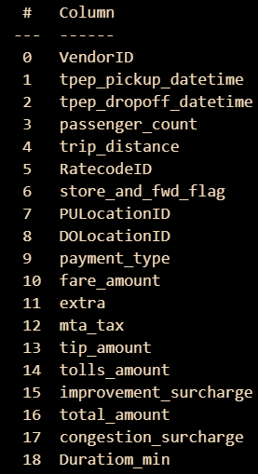
Data overview
I used taxi trip data 2020 from data.gov website here you can find multiple dataset with multiple supported file format and use them for your analysis
Analysis was performed using columns:
Passenger count – total no of passenger in trip
Payment type – Cash , card
Fare amount – amount of whole trip
Duration – how long trip lasted
Trip distance – distance travelled

Slide 6
Methodology
Step | Description
Descriptive analysis | Performed statistical analysis to summarize key aspects of the data and get necessary insights
Hypothesis testing | Performed t-test to validate that our findings are true and not just random
Regression analysis | Regression analysis to predict fare amount based on the distance travelled

Slide 7
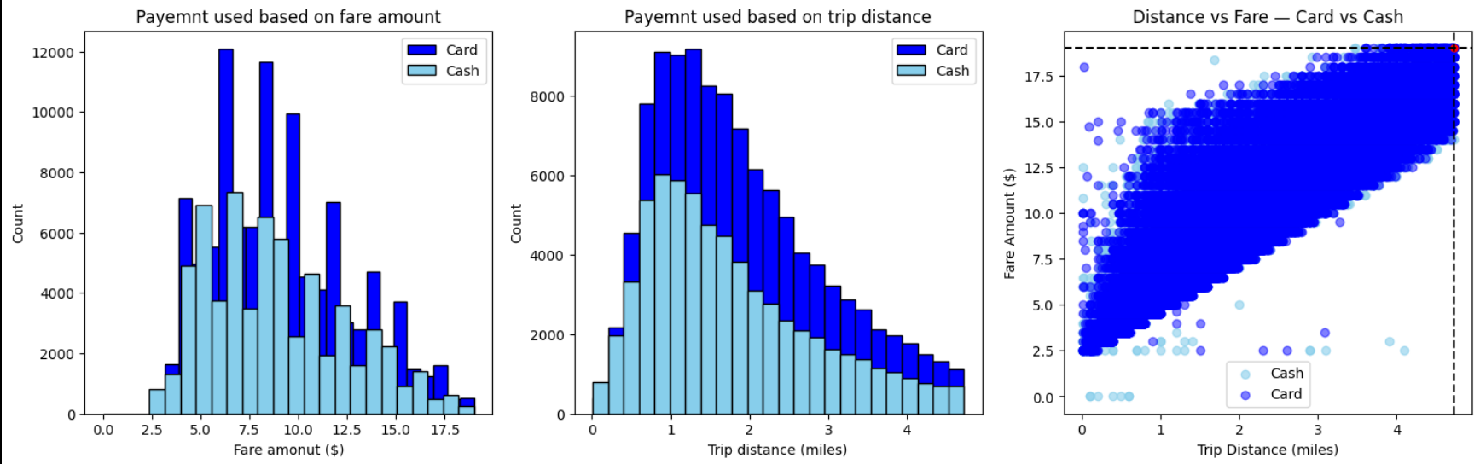
Travel insights
People paying with card have slight higher average trip distance and fare amount compared to people paying with cash
People used to pay more with card when the fare amount and travel distance is high instead of cash
Payment type | Fare amount |  | Trip distance
 | std | mean | std | mean
Card | 3.98 | 9.5 | 1.21 | 2.00
Cash | 4.03 | 9.29 | 1.27 | 1.91

Slide 8
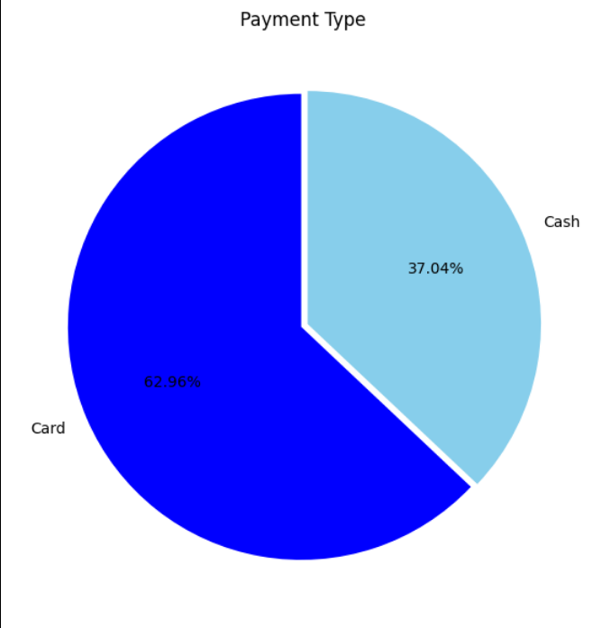
Preference of payment type
Based on the chart people paying with cash is 37% and people paying with card is 63% which suggest people tend to pay more with card compared to cash

Slide 9
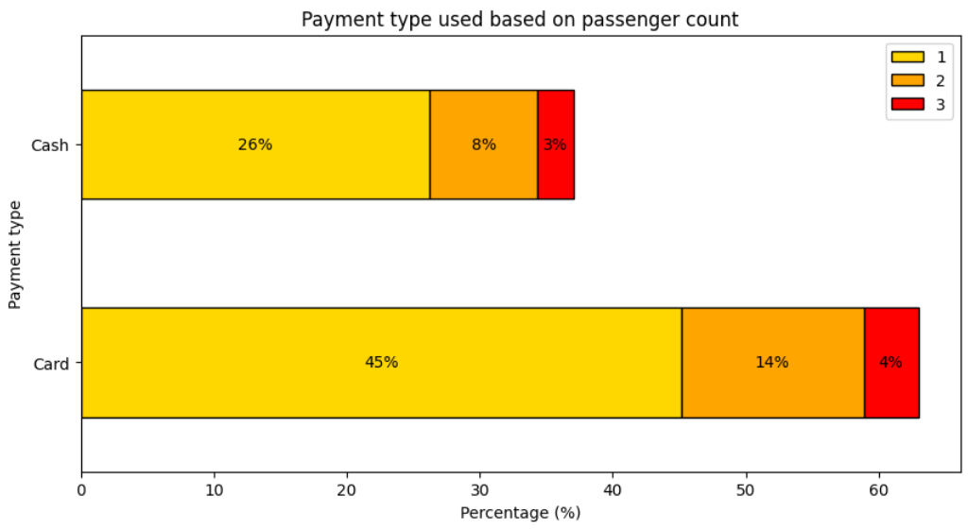
Passenger count analysis
Based on the passenger count we can also see that single passenger also prefer to pay more with card compared to cash

Slide 10
Hypothesis testing
Even the sample size was large we still used t-test for our hypothesis testing instead of z-test because the distribution was not normal and we didn’t knew the standard deviation and mean of the population
Null hypothesis: There is no significant difference between the payment method
Alternative hypothesis: there is a significant difference between the payment method
Our p value was less than significance value and t-score was also high (14.5) hence we rejected our null hypothesis

Slide 11
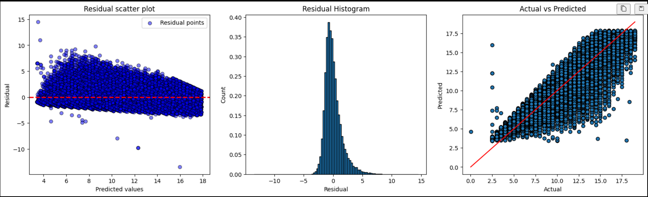
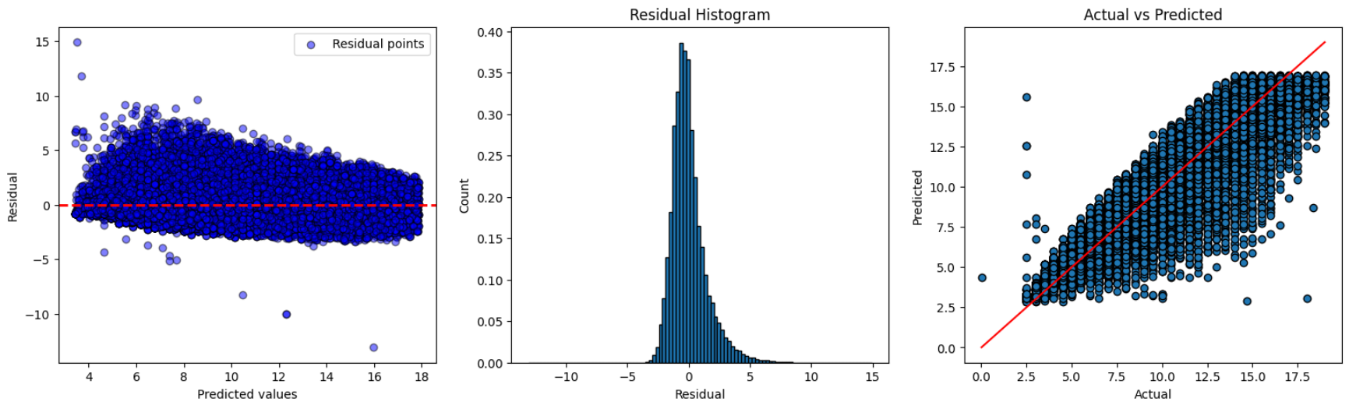

Regression analysis
We used Linear regression , randomforest regression and gradient boosting to create a predictive model which can tell for a certain distance of trip how much charge will be there
Linear regression
Random forest
Gradient boosting

Slide 12
Thank you

